Slide 1



Olympics Dashboard
View in Power BI
Last data refresh:
04/05/2025 23:07:54 UTC
Downloaded at:
04/05/2025 23:09:17 UTC

Slide 2
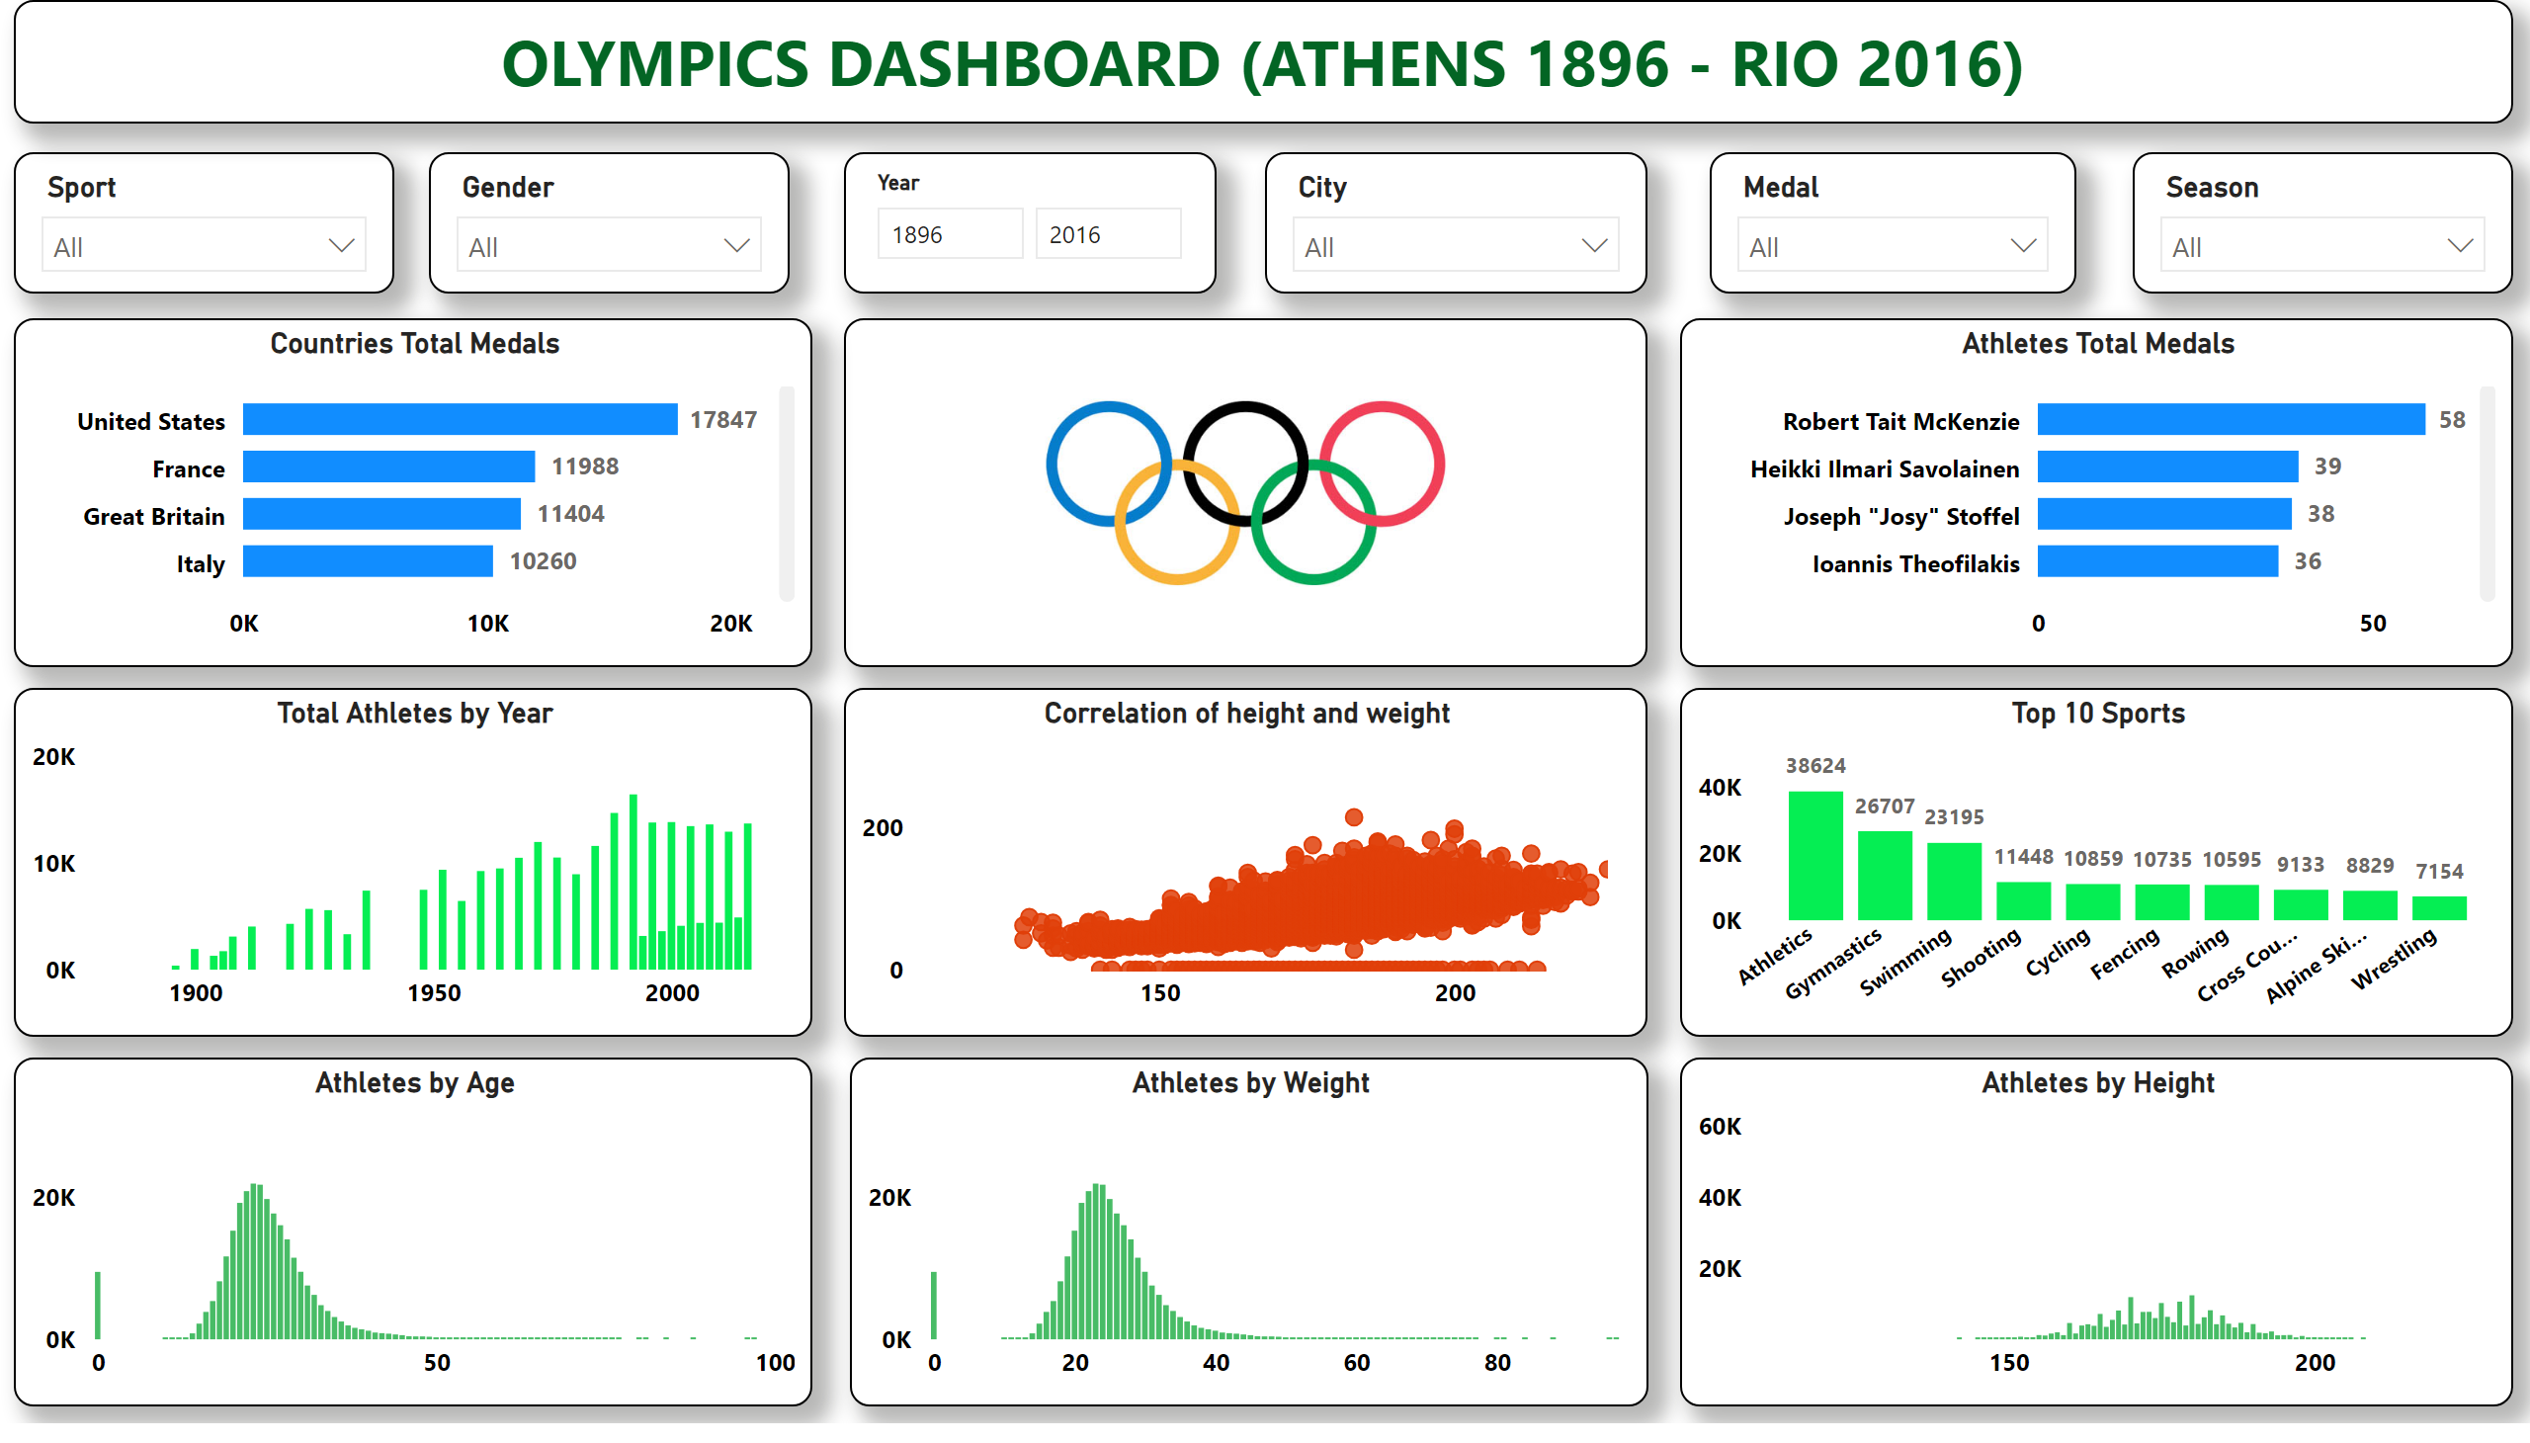
Page 1
Notes:
slicer
No alt text provided
textbox
No alt text provided
slicer
No alt text provided
slicer
No alt text provided
slicer
No alt text provided
slicer
No alt text provided
slicer
No alt text provided
image
No alt text provided
Countries Total Medals
No alt text provided
Athletes Total Medals
No alt text provided
Total Athletes by Year
No alt text provided
Top 10 Sports
No alt text provided
Correlation of height and weight
No alt text provided
Athletes by Age
No alt text provided
Athletes by Weight
No alt text provided
Athletes by Height
No alt text provided

